Slide 1
Lecture 10: Letter Writing
Note: Sharing or editing the video using any software or website is strongly prohibited.

Slide 2
Letter
Definition: A document used for external communication.
Types
1-Formal 2-Informal
Uses
External and internal communication
• Record keeping
• Informing
• Instructing
• Appreciating
• Assigning Responsibilities

Slide 3
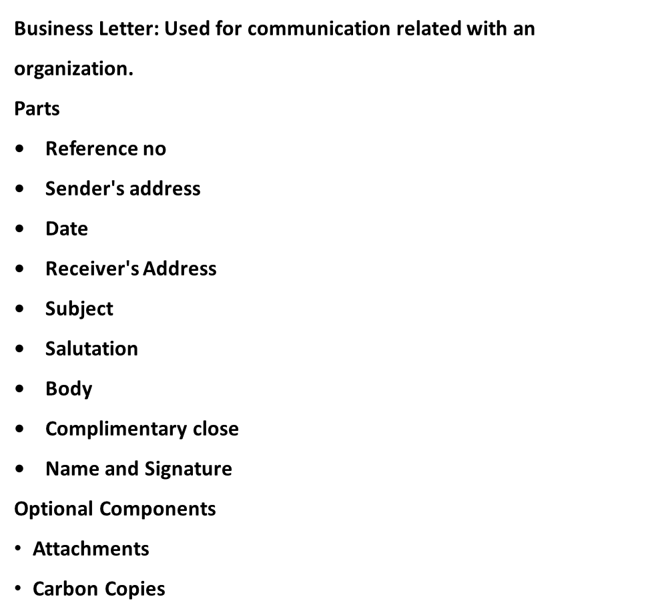

Slide 4
Full Block Format
123 Anywhere Place
London
SW1 6DP
1 July, 2014
Mr John Smith XYZ Partnership 10 Utopia Drive London SW11AE
Dear Mr Smith:
My former colleague Joan Brown informed me that you are seeking to hire an office manager. I worked with Ms Brown at Acme and have 10 years of experience as an administrative assistant. I have long admired XYZ Partnership and would be honoured to work for your company.
As you can see from my CV, I have performed many administrative duties in my previous positions at Acme and Ajax. At Ajax, I facilitated the company's transition from handwritten to digital records. That work paved the way for my move to Acme, where I assisted the director of innovation in tracking the development of new products. I helped introduce the company's workflow management system, which enabled Acme to cut the average development time of its software upgrades from 18 weeks to 12 weeks.
I would be pleased to speak with you to discuss the details of the office manager position. Thank you for your consideration of my application.
Best regards,
Jane Clark

Slide 5
Block Format
123 Anywhere Place
London
SW16DP
1 |uly, 2014
Ms Joan Brown XYZ Partnership 10 Utopia Drive London SW11AE
Dear Joan
Thank you so much for informing me of the vacancy at XYZ Partnership I appreciate all the support you have given me throughout my career, and I would be delighted to work alongside you once again. In order to build upon my qualifications, 1 have applied to the evening administrative degree program at St John's College. I would greatly appreciate it if you would be willing to serve as one of my references.
In the year since you left Acme, 1 have taken on additional duties as Mr Jones's administrative assistant In November, the company introduced a proprietary workflow management system, and I was charged with ensuring that each department received die upgrade on schedule. Additionally, I completed 20 hours of software training in order lo mput updates. As a resulL I was able to pursue certification in Microsoft Office, which 1 received last month.
Fur your rclercnce, I have also enclosed a copy of my current CV. Please let me know if you would like any additional information. Thank you once again for your help
Regards,
Jane

Slide 6
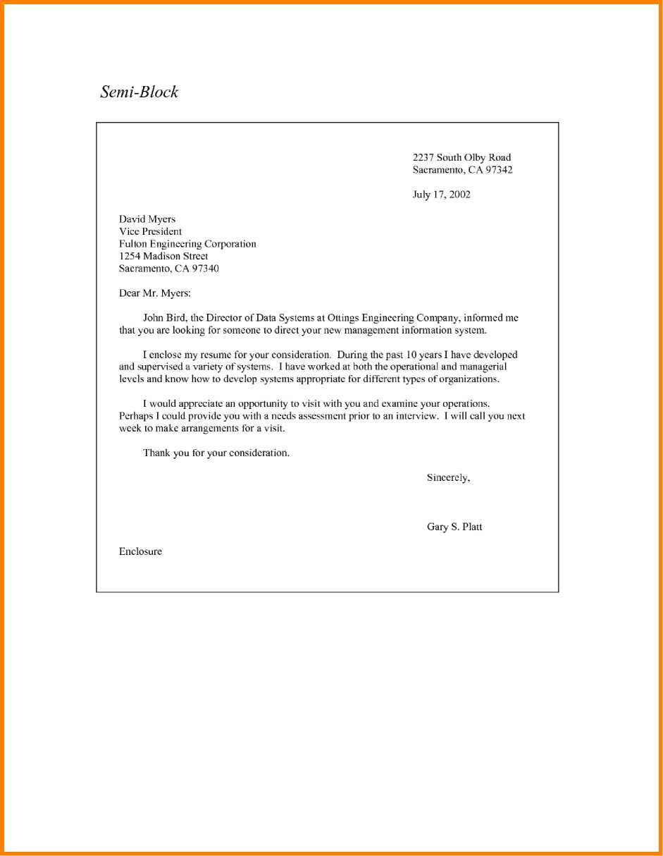
Semi Block Format
Reference Number: PKK-1234.BEC/BES-01

Slide 7

Aftab Ali
Managing Director ABC Communications Street No.02, F07, Islamabad Ph: 051-099876 Mob: +92-307 2345678 aftab@gnmail.com
Date: March 31, 2020
Ahmad Ali Managing Director XYZ Communications Street No. 02, Barkat Market Lahore
Ph: 042-987789 Mob: +92-345678921 ahmadali@gmail.com
Subject: Invitation to a Seminar on Media Communications
Dear Sir,
We cordially invite you to a seminar on Media Communications being organized at ABC Communications, Islamabad. The major theme of the seminar is to control social media information. There will be several delegates from foreign countries who will not only be participating but also presenting on various topics.
The seminar will start at the Main Auditorium on April 03, 2020 at 8am. Your participation will be highly appreciated.
Warm Regards,
Aftab Ali
Managing Director ABC Communications Street No.02, F07, Islamabad Ph: 051-099876 Mob: +92-307 2345678

Slide 8
Thank You

